Slide 1

PROJECT 1 BIAS & UNBIAS COIN FLIP 黎信義 B10817055

Slide 2
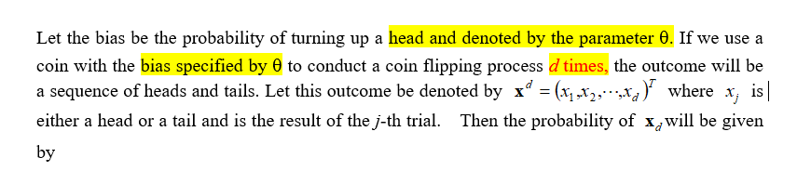

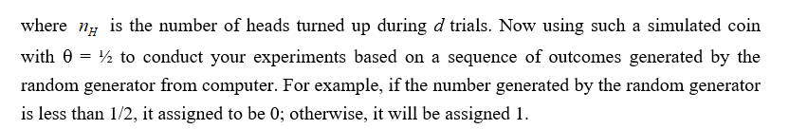
Main Discussion
In order to run your computer project, run the following cases
d = 100 and n =100 using a simulated coin with q = ¼ and ½.
d = 10 and n =1000 using a simulated coin with q = 1/3 and ½.
d = 100 and n = 10000 using a simulated coin with q =2/5 and ½.
d = 100 and n = 10000 using a simulated coin with q =3/5 and ½.
draw your conclusions.

Slide 3
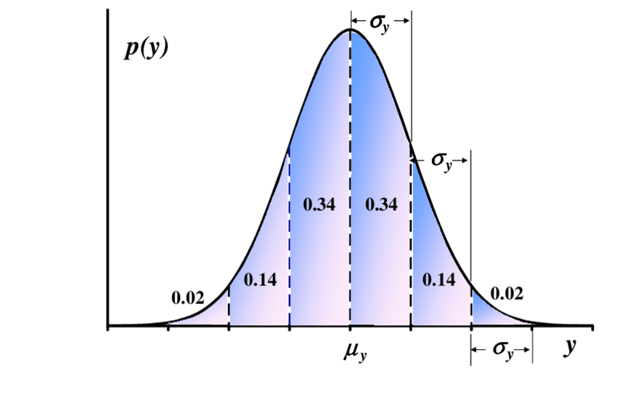
Bias and Unbiased coin
In this experiment we are going to simulate a coin flip with different bias value.
This experiment are going to be divided into 4 steps,
Generate a random value and compare it with our desired Theta(bias).
If random value < theta = heads
If random value > theta = tails
We conduct the flips for d times, this will generate the first random variables.
Using the first random variables that we obtain, Repeat step 2 for n times to get the second random variables
Plot the histogram of the result and in theory the result will always be or similar to a gaussian distribution curve (The higher the test amount, the more similar our curve to gaussian distribution curve)

Slide 4
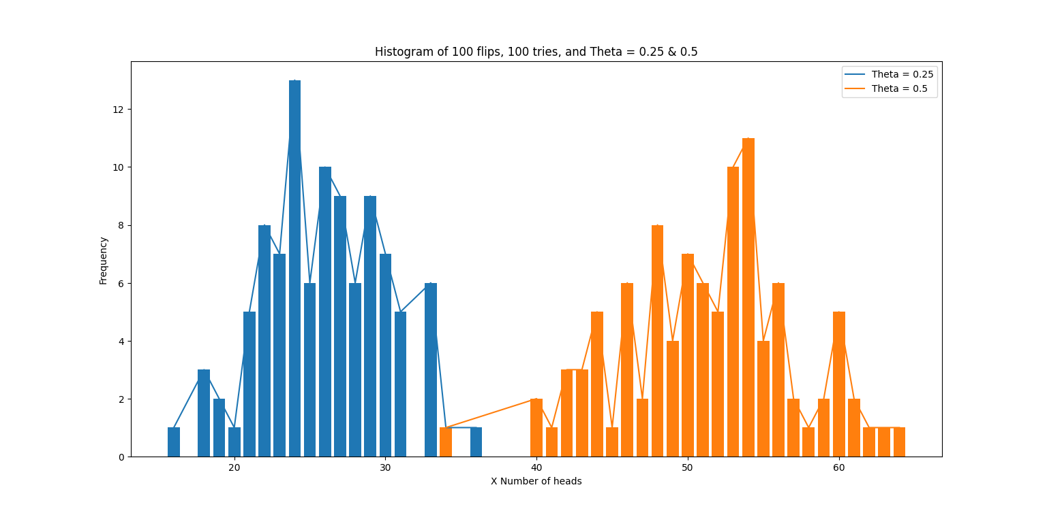
(Test Case 1) d = 100 and n =100 using a simulated coin with q = ¼ and ½
From this table we can see that higher theta makes the graph located more to the right. With 0.5 theta indicates it’s a fair coin toss with head to tail probability ratio of 50:50. Even though some of the highest frequency is not located exactly in 50 we can see that number of heads are more concentrated close to 50. This is due to insufficient data/tries since we only try it 100 times for 100 flips.
Blue graph indicate coin with head Theta=0.25 so obviously number of heads that will be generated is significantly smaller compared to coin with Theta = 0.5

Slide 5
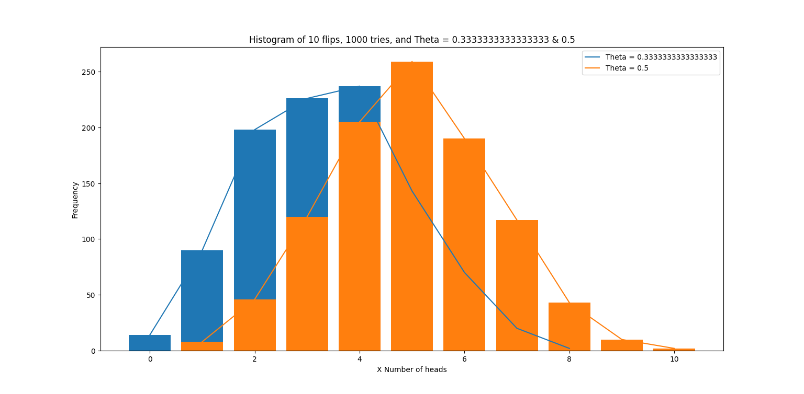
(Test Case 2) d = 10 and n =1000 using a simulated coin with θ = 1/3 and ½.
From this table we can see that 0.5 theta indicates it’s a fair coin toss with head to tail probability ratio of 50:50. As we can see the orange diagram highest value is in x=5 meaning in 10 toss we get 5 heads and 5 tails. And the graph is already similar to gaussian curve because we use 1000 tries for the experiment
Blue graph indicate coin with head Theta=1/3 so obviously number of heads that will be generated is smaller compared to coin with Theta = 0.5 but there are a lot of area that stack on each other.

Slide 6
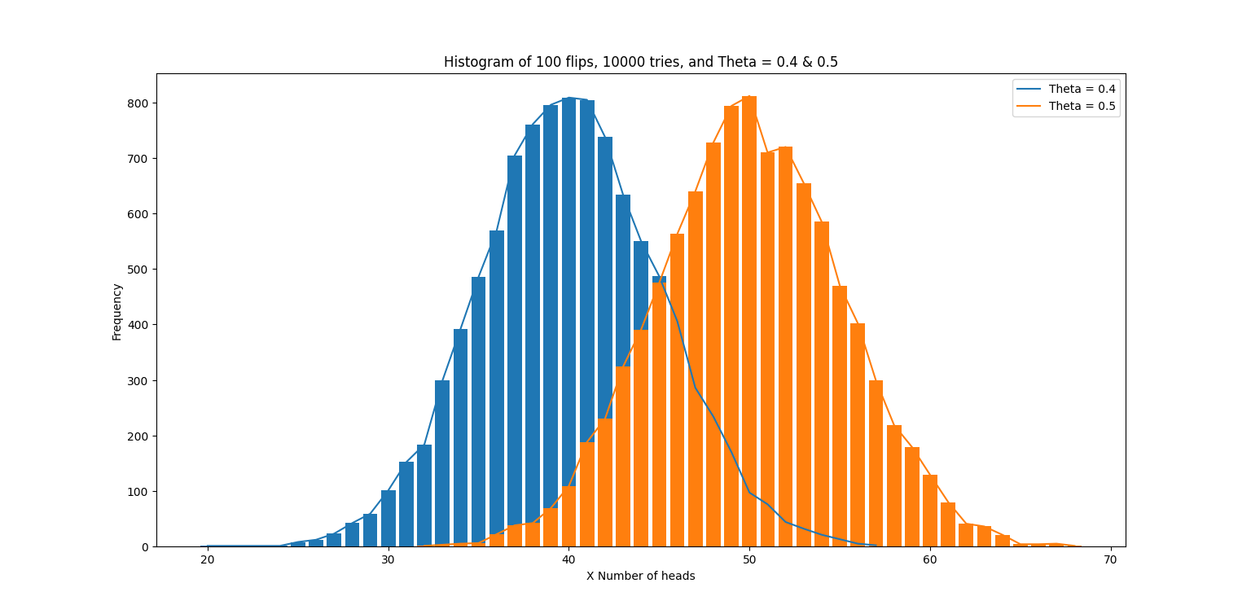
(Test Case 3) d = 100 and n = 10000 using a simulated coin with θ =2/5 and ½.
In this diagram we conduct 100 flips per tries with a total of 10000 tries and we can see that the gaussian curve more clearly. And still when the theta is 0.5 the head probability adds up to 50 and tails 50. and since 2/5 < ½ we can conclude that head probability for blue graph will be smaller there fore the graph sticks more to the left

Slide 7
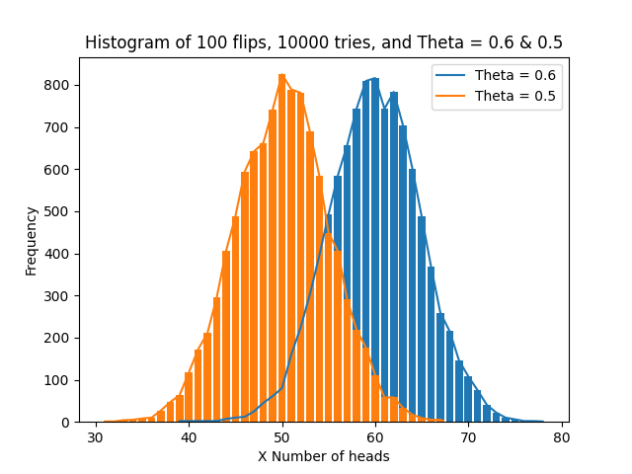
(Test Case 4) d = 100 and n = 10000 using a simulated coin with θ =3/5 and ½.
This time blue graph has a theta of 0.6 therefore the graph is more to the right from 0.5 theta graph. Meaning head probability is higher and most of the times in every tries we get 60 heads and 40 tails when the theta is 3/5.

Slide 8
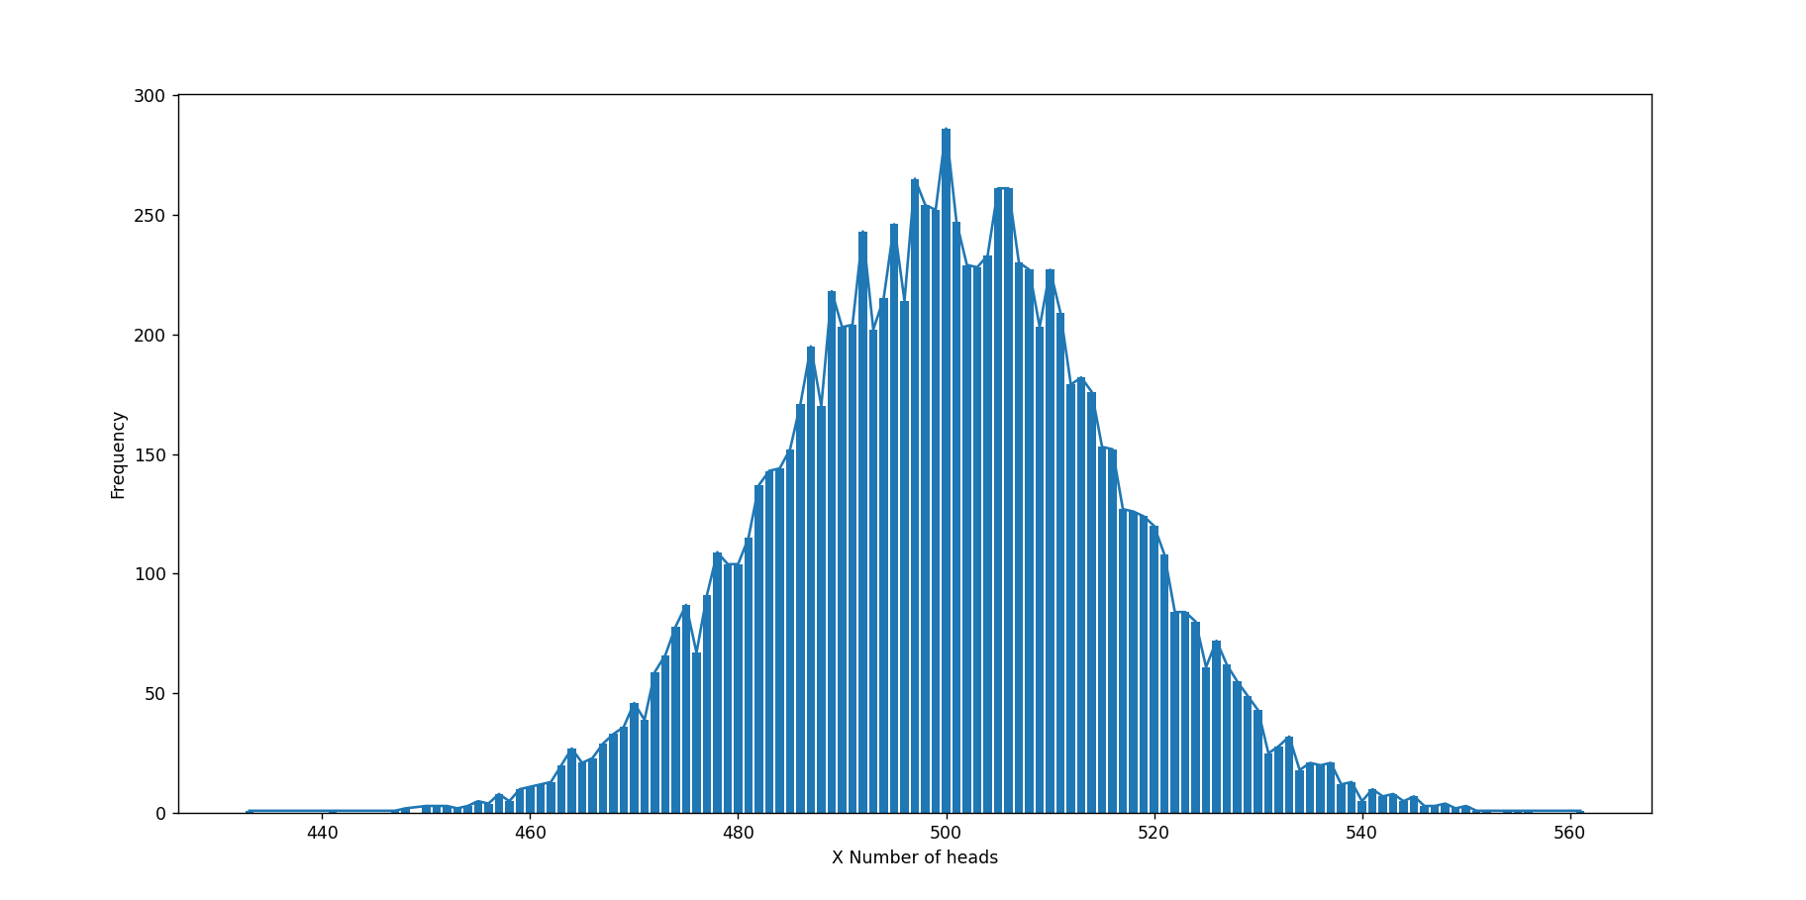
Conclusion
1000 flips in 10000 tries theta = 0.5
From this experiment we can conclude that higher test case or tires will make the graph result more similar to gaussian distribution
And the higher the theta the graph will be more to the right and vice versa.
When we conduct the experiment with low amount of data there was little to none results that are stacking and when we retry it with a higher amount of data we can see a lot of stacking value when the theta of 2 testcase are close.

